Slide 1

Mental Health Risk Prediction Using Social Media
Sentiment Analysis
GROUP NO : 1
TASMIA HOSSAIN 20210204038
ABU DOJANA 20210204039
MD. AHNAF AHSAN 20210204048

Slide 2
Table of Content
01
02
03
INTRODUCTION
LITERATURE REVIEW
DATASET ANALYSIS
04
05
06
METHODOLOGY
RESULT ANALYSIS
CONCLUSION
2

Slide 3



Introduction
Mental Health: 970M+ people affected worldwide
Problems with Usual Screening: Slow, hard to access, stigma, subjective results
Social Media Help: Can show emotions and behavior in real time
Green AI: ML models should be accurate but use less energy
Our Goal: Build smart ML models, check features, compare performance and CO₂ use, suggest best solution
3

Slide 4





Literature Review
CHALLENGES
Labels not always accurate
Different platforms = different results
Few clinical tests
SOCIAL MEDIA & MENTAL HEALTH
Online posts reflect mental health
Signals: words, emotions, activity
KEY STUDIES
Twitter → depression signs
Instagram → photo features matter
Facebook → language predicts depression
Posting time + mood → suicidal risk
4

Slide 5
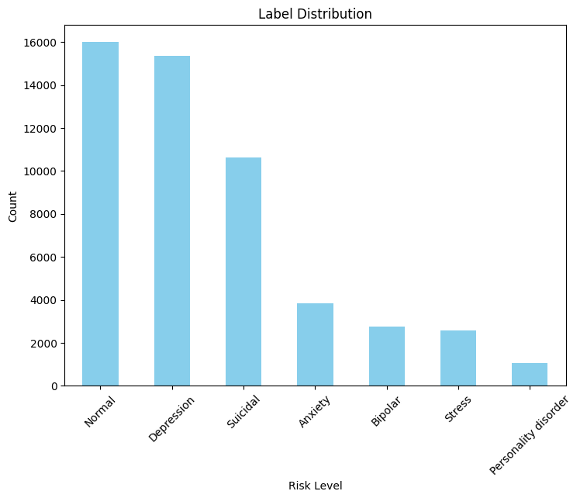

Dataset Analysis
COMPREHENSIVE DATASET STATISTICS
Total samples: 52,266 after preprocessing
Categories: 7 mental health conditions
Average text length: 572.3 characters
Average word count: 112.0 words
BINARY CLASSIFICATION FRAMEWORK
High-risk conditions: Depression, Suicidal, Anxiety, Bipolar, Stress, Personality disorder (69.4%)
Low-risk condition: Normal (30.6%)
5

Slide 6

Methodology
FEATURE ENGINEERING
Sentiment: VADER & TextBlob
Linguistic patterns: text length, punctuation, capitalization
Mental health keyword detection
TF-IDF vectorization (1,000 features)
Final feature matrix: 1,009 dimensions
MACHINE LEARNING MODELS
Six algorithms: Logistic Regression, Random Forest, Gradient Boosting, Linear SVM, Naive Bayes, Neural Network
Hyperparameter optimization applied
CARBON EMISSION TRACKING
CodeCarbon integration for CO₂ monitoring
Real-time tracking of energy, training time, emissions
6

Slide 7

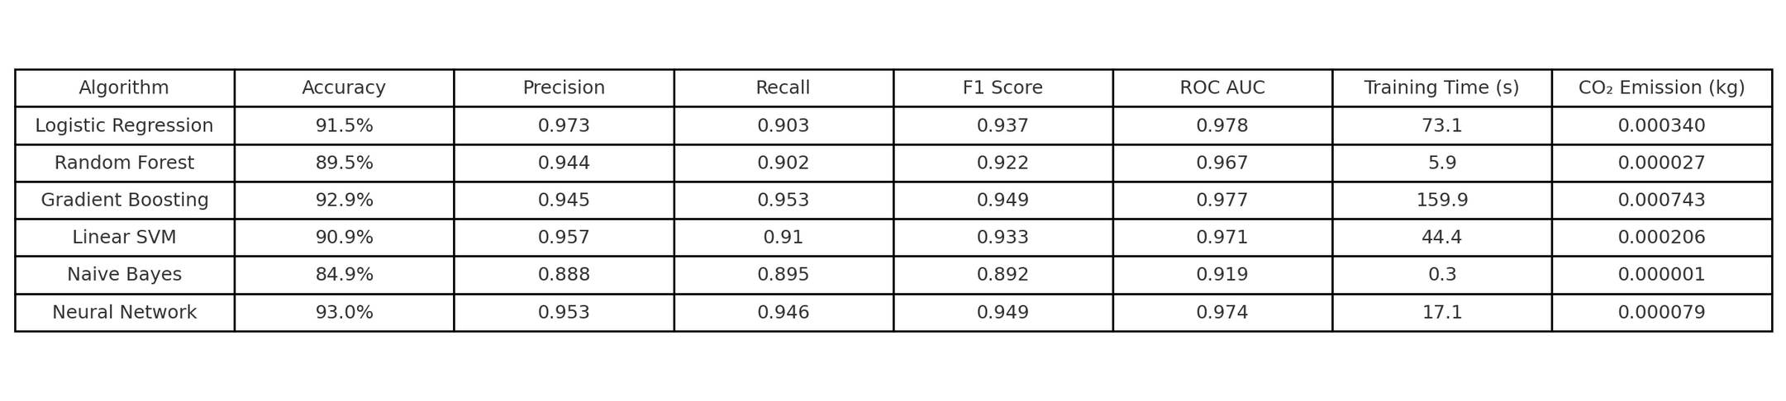
Result Analysis
TABLE: COMPREHENSIVE PERFORMANCE COMPARISON WITH CARBON EMISSION ANALYSIS
7

Slide 8
Conclusion
Neural Network achieved highest accuracy (93.0%) with excellent ROC AUC (0.974)
Naive Bayes provided most sustainable solution with minimal CO₂ emissions (0.000001 kg)
Comprehensive Green AI analysis enables informed deployment decisions
8

Slide 9

THANK
YOU

